Slide 1
CS205
Hand-Interactive System Based on yolov3
12011437 邬静芙 计算机科学与技术
12011220 张德超 智能科学与技术
12011119 卓著 智能医学工程

Slide 2




C
ONTENTS
01
Task Division and Contribution Ratio
02
Introduction & Highlights
03
Problems & Sloutions
04
Demo Display

Slide 3
Task Division and Contribution Ratio
邬静芙（33%）
Trajectory recognition and graph fitting
GUI and Mode-switching design
Report typesetting
张德超（0.33）
Implement controlling functions of cursor
Code combining
Report typesetting
卓著（1/3）
Locate and track the hand
Detect hand gesture
Code combining

Slide 4
Introduction
Overview
Hand gesture Detection & Tracking
Cursor Control & Image Overlay
Trajectory Detection & Graphics Modification & Image Saving

Slide 5
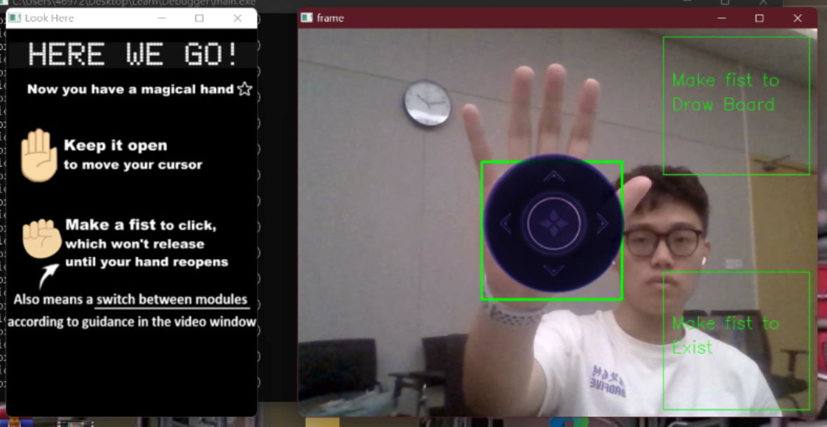
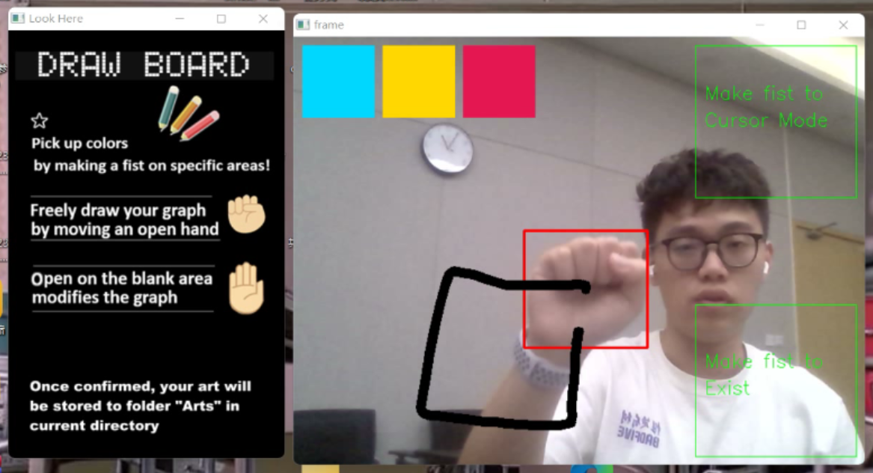
The system consists of two modes：
1)Cursor controlling interface
2)Draw board
Entering and existing are detected by making a fist on specific areas.

Slide 6
Hand gesture detection
Hand detection based on yolo-v3 tiny network.
Algorithm for eliminating bounce.
Detection on hand gesture.

Slide 7
Hand Detection Based on Yolo-v3 Tiny Network
To detect hand gestures, we first have to detect the hand position in space. This pre-trained network is able to extract hands out of a 2D RGB image, by using the YOLOv3 neural network.
We used open configuration sources for yolo hand detection and load the model using cv::dnn::readNetFromDarknet.

Slide 8
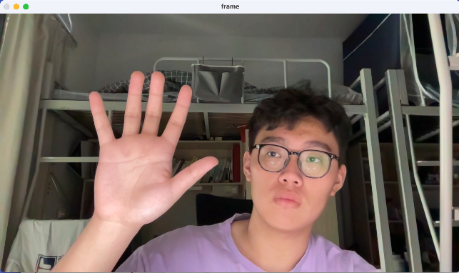
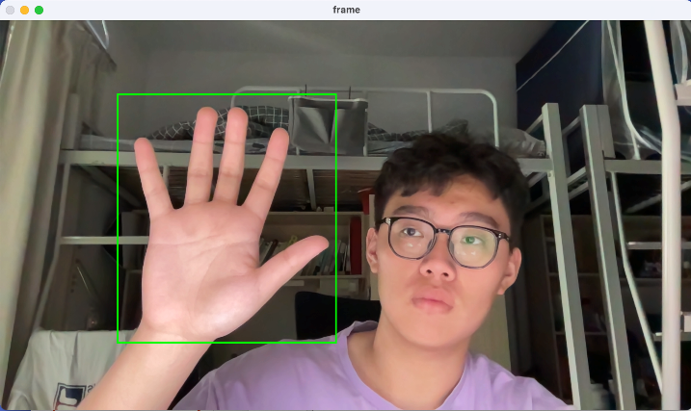


Hand Detection Based on Yolo-v3 Tiny Network
（416 x 416 x 3)
（416 x 416 x 3)
（1920 x 1080 x 3)
（1920 x 1080 x 3)
Capture a frame from webcam.
Resize the mat to fit the input of yolo-v3 network.
Forward pass in network.
Get the value in the output layer, x, y, w, h and confidence, respectively.
Get the box in the previous scaler.
Repeat the steps above.

Slide 9
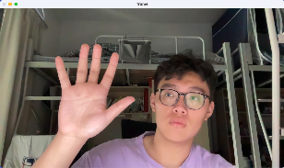
Algorithm for eliminating bounce.
Due to the bounce of detection boxing. It is hard to complete the following tasks. So we design an algorithm to eliminate bouncing.
We push back the frame into a deque and pop front frame when the size reaches the upper bound. The bound is fit to the performance to a certain computer.
We do calculation on the deque to get the box we want.
…
frame: enqueue
frame: dequeue
(to keep the queue size)

Slide 10
Algorithm for eliminating bounce.
Algorithm:
1. Cull boxes whose bias is too large.
2. Get the average value of the parameter of the remaining boxes.
3. Return the value.

Slide 11
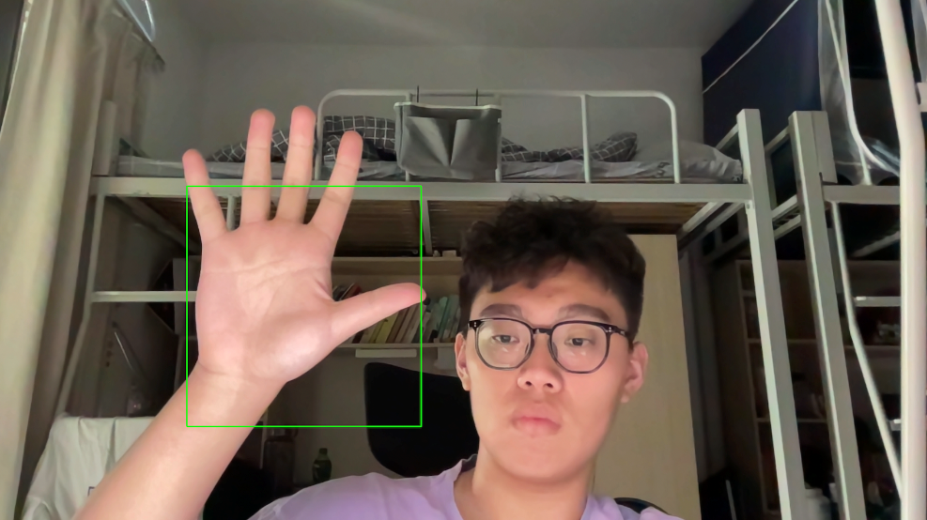
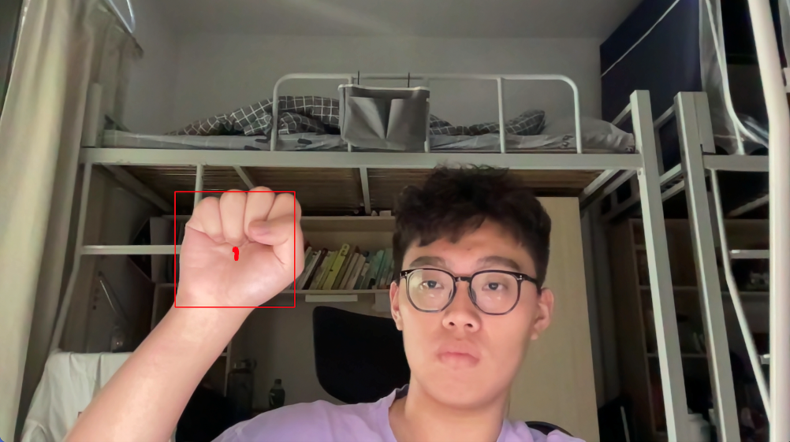
Detection on hand gesture
After implementing the algorithm for eliminating the bounce, it is easy to implement detection on whether hand is open or closed according to the size of the box.
Use two different states to do different operations

Slide 12
Introduction
Overview
Hand gesture Detection & Tracking
Cursor Control & Image Overlay
Trajectory Detection & Graphics Modification & Image Saving

Slide 13
Cursor Control
<windows.h>
six directions

Slide 14
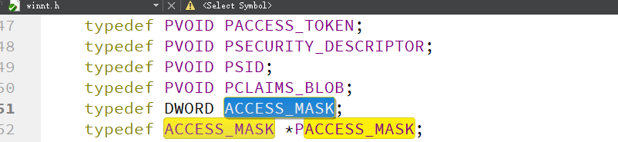
Problems & Sloutions
reference to ‘ACCESS_MASK’is ambiguous
delete using namespace cv

Slide 15
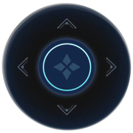
Image Overlay
filter out the white background
two-level for loop

Slide 16
Mode Switch
top right corner

Slide 17
Problems & Sloutions
switching frequently
counter (10 frame)

Slide 18
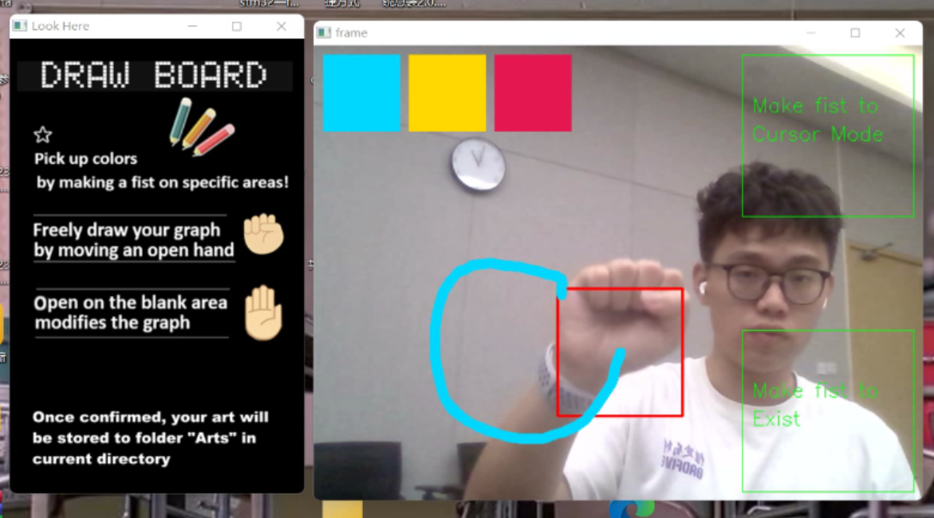
Brush Color Switching
top left corner

Slide 19
Introduction
Overview
Hand gesture Detection & Tracking
Cursor Control & Image Overlay
Trajectory Detection & Graphics Modification & Image Saving

Slide 20
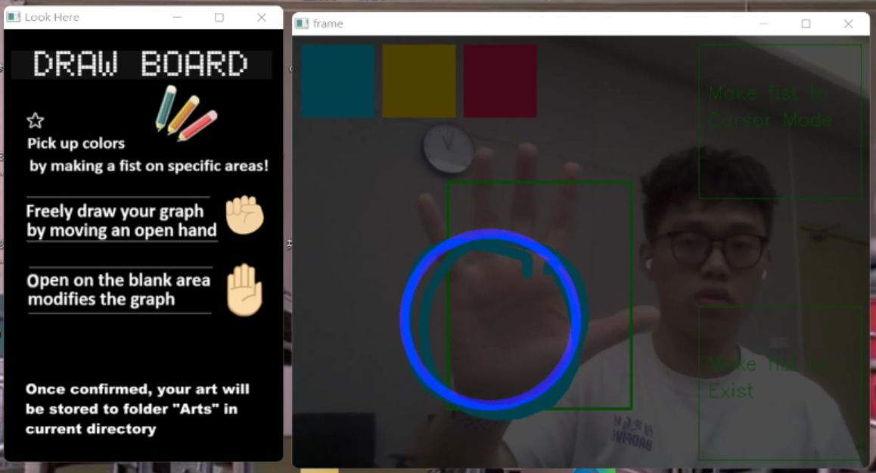
Trajectory Detection & Graphics Modification
vector<cv::Point>newPoints cv::approxPoly
circle

Slide 21
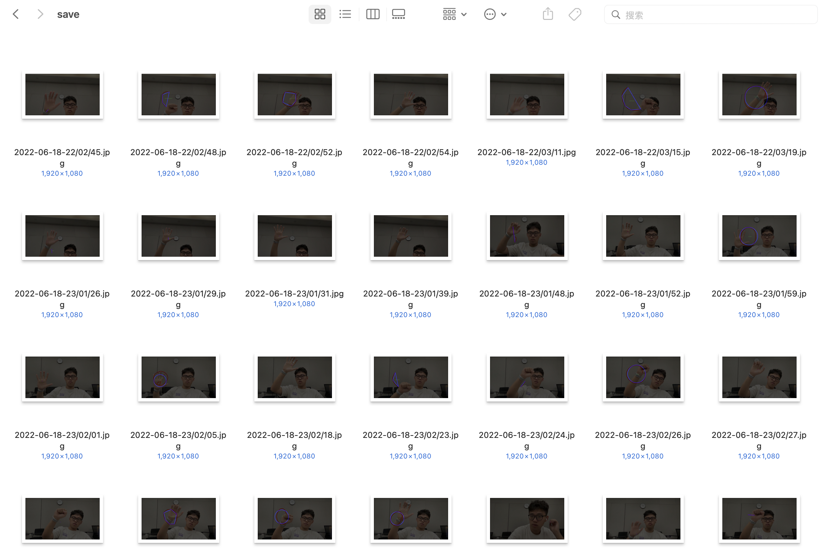
Image Saving
circle

Slide 22
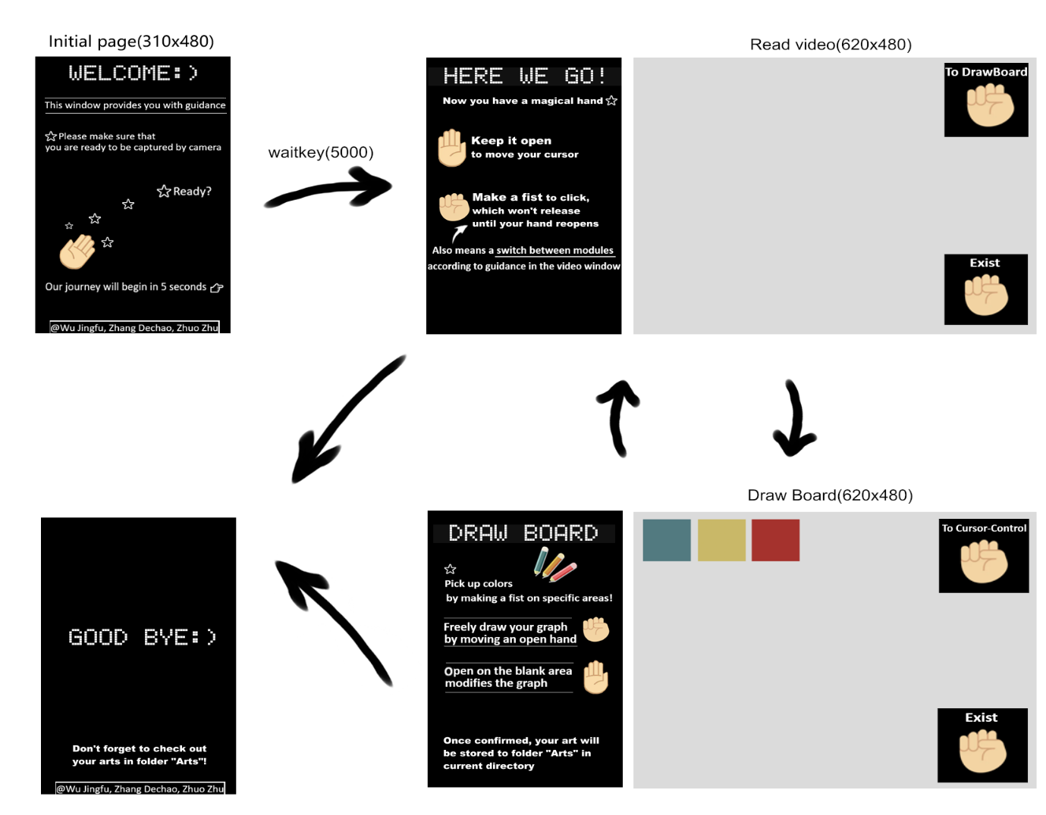
· Beautiful GUI
· Changeable color
· Enhanced interaction

Slide 23
Problems&Solutions
1) Gradual change failed: We attempted to achieve gradually switch between raw graph and fitted graph via function cv::addWeighted, but it effects the continuous reading of video stream.
Solution: We tried and gave up this functional implement.
2) Enclosed graphic: Outliers(some points far away from the main part) occurred when fitting and draw the graphics.
Solution: It turned out that the graphic needed to be enclosed, we obtained it by connecting newPoints[0] and newPoints[size-1].
2) Window size: changing devices effects the relative position of windows’ components
Solution: Use functions like resizeWindow and moveWindow to determine their absolute position.

Slide 24
Demo Display

Slide 25
THANK YOU FOR LISTENING

